Slide 1
Probability: Basics
CS 2402 Lecture 3

Slide 2
Objectives
Probability definition
How to compute probability
Applications
The birthday problem
DNA fingerprinting
Engine failure in airplanes
Electronic system

Slide 3
Probability Definition

Slide 4


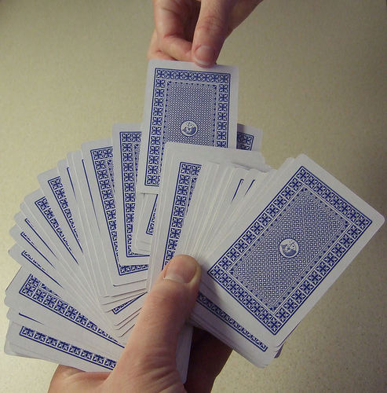

Random Experiments
An experiment (e.g., a game) with a random outcome
Experiment can be repeated many times
Each repetition is called a trial
flip a coin
roll a dice
draw a card
spin a wheel

Slide 5
Outcomes and Sample Space
An outcome (sample) is a possible result of an experiment
Outcomes are unique
Outcomes are mutually exclusive (not overlapping)
Sample Space = the set of all the possible outcomes
flip a coin
Outcomes:
Heads, Tails
Sample Space = {H, T}
roll a dice
Outcomes:
1, 2, 3, 4, 5, 6
Sample Space = {1,2,3,4,5,6}

Slide 6
Event
An event is a set of outcomes, i.e., a subset of the sample space
Consists of zero or more outcomes
Events do not need to be mutually exclusive
flip a coin
roll a dice
Events:
1, 2, 3, 4, 5, 6,
Even, Odd,
{1, 2, 3},
{3, 4},
…
Events:
Heads, Tails, {H, T}

Slide 7
Probability
The probability of an event is the relative frequency of occurrence in the experiment
Probability of event E is
P(E) =
The value of P is between 0 and 1, inclusive
Assume that each outcome has the same relative frequency
The sample space
number of outcomes in E
total number of possible outcomes
event E

Slide 8
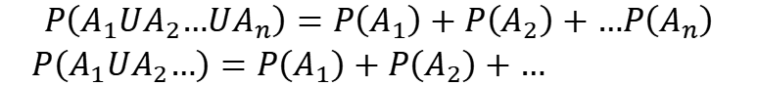
Math Definition of Probability
Probability is a way to assign numbers to events, which satisfies:
For any event A
If S is the sample space, P(S) = 1
For a finite or infinite sequences of disjoint events
$$P\left(A_{1}UA_{2}…UA_{n}\right)=P\left(A_{1}\right)+P\left(A_{2}\right)+…P\left(A_{n}\right)$$
$P\left(A_{1}UA_{2}…\right)=P\left(A_{1}\right)+P\left(A_{2}\right)+…$

Slide 9
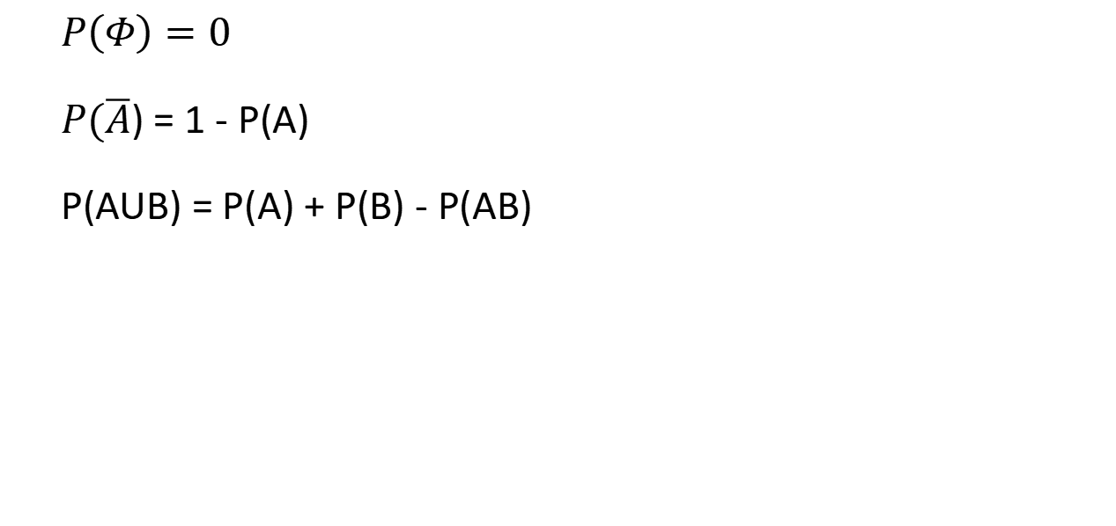
Properties of Probability
$P\left(Φ\right)=0$
$P(\overline{A}$) = 1 - P(A)
P(AUB) = P(A) + P(B) - P(AB)

Slide 10
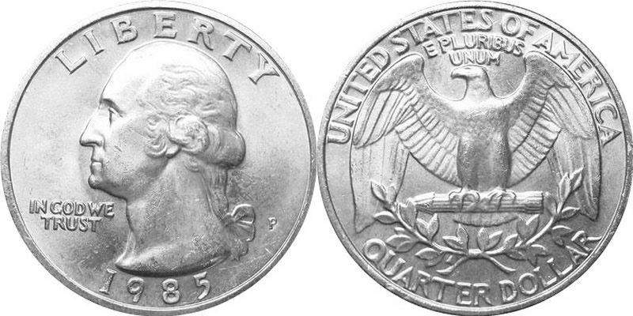
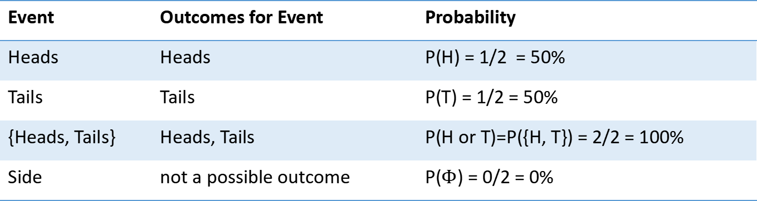
Example: Coin Flip
2 outcomes: Heads, Tails
Sample Space = {H, T}
Probability of events
Event | Outcomes for Event | Probability
Heads | Heads | P(H) = 1/2 = 50%
Tails | Tails | P(T) = 1/2 = 50%
{Heads, Tails} | Heads, Tails | P(H or T)=P({H, T}) = 2/2 = 100%
Side | not a possible outcome | P($Φ$) = 0/2 = 0%

Slide 11
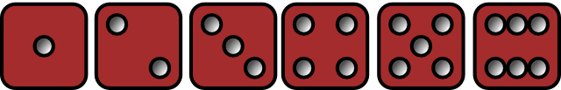
Example: Roll Dice
6 outcomes: 1, 2, 3, 4, 5, 6
Sample Space = {1, 2, 3, 4, 5, 6}
Probability of events
Event | Outcomes for Event | Probability
3 | 3 | P(3) = 1/6
Even | 2, 4, 6 | P(Even) = 3/6 = 1/2
Larger than 2 | 3, 4, 5, 6 | P(Larger than 2) = 4/6 = 2/3
{1, 6} | 1, 6 | P({1,6}) = 2/6 = 1/3

Slide 12
Probability
Summary:
Terminologies: outcome, sample space, event
Math definition: probability is a value for an event. It meets three conditions

Slide 13
How to Compute Probability

Slide 14
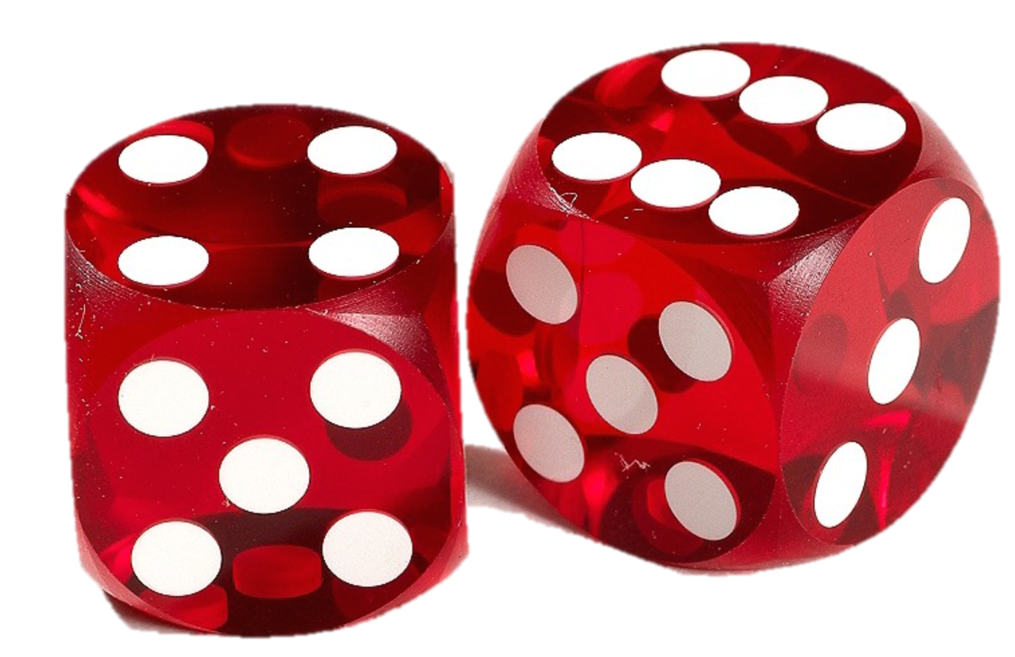
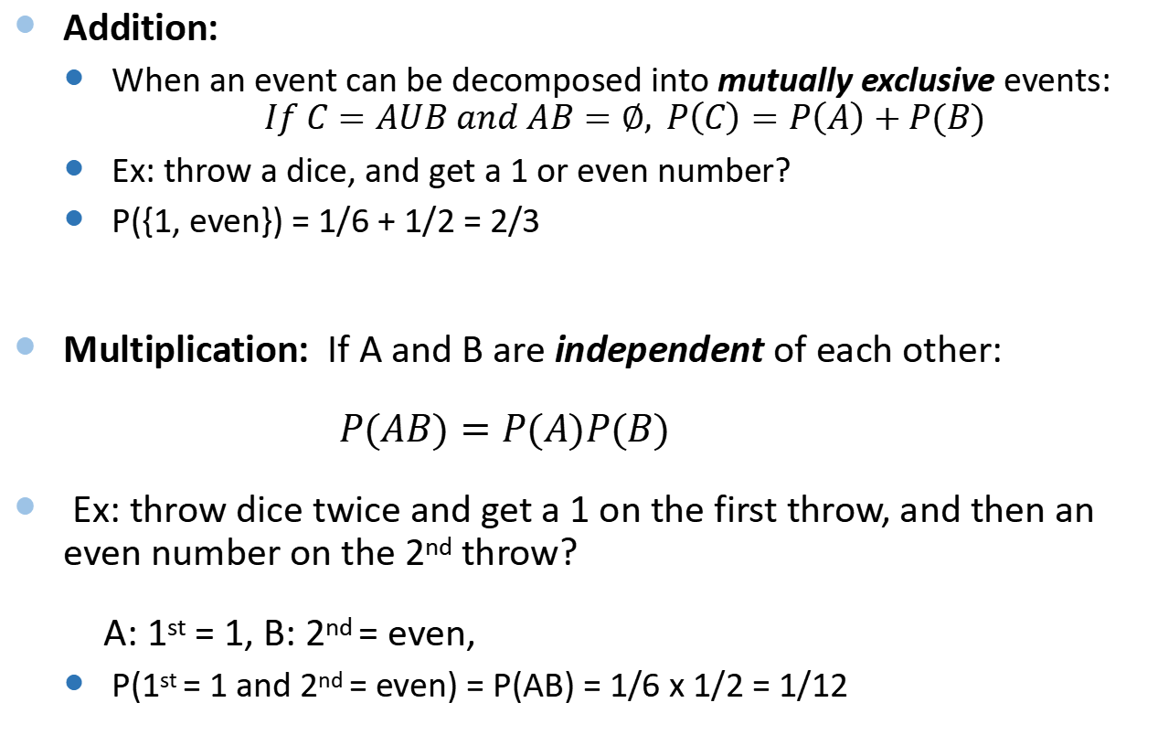
Rules of Probability
Addition:
When an event can be decomposed into mutually exclusive events:
$$If C=AUB and AB=∅, P\left(C\right)=P\left(A\right)+P(B)$$
Ex: throw a dice, and get a 1 or even number?
P({1, even}) = 1/6 + 1/2 = 2/3
Multiplication: If A and B are independent of each other:
$P(AB)=P(A)P(B)$
Ex: throw dice twice and get a 1 on the first throw, and then an even number on the 2nd throw?
A: 1st = 1, B: 2nd = even,
P(1st = 1 and 2nd = even) = P(AB) = 1/6 x 1/2 = 1/12

Slide 15
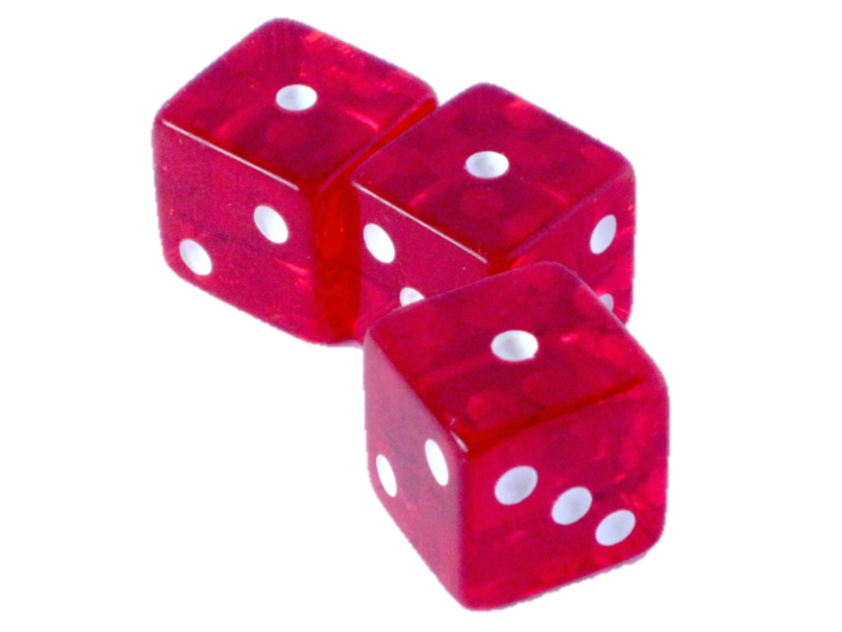
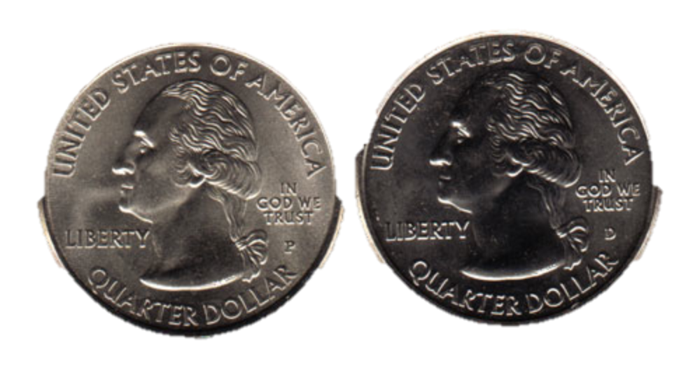
Independent Events
Related to the “rule for multiplication” is the notion of independent events
Two events are independent if they do not influence each other
Ex: flip a coin twice, or throw three dice
Let E and F be two independent events
The probability that both events occur is the product of the event probabilities:
P(EF) = P(E) x P(F)

Slide 16
Example: Two Dice
What is the probability that the 1st dice is 4 and the 2nd dice is 6?
A: 1st dice is 4, P(A) = 1/6
B: 2nd dice is 6, P(B)= 1/6
P(1st dice is 4 and 2nd dice is 6) = P(AB) = 1/6 x 1/6 = 1/36
What is the probability that the 1st dice is 6 and the 2nd dice is 4?
P(1st dice is 6 and 2nd dice is 4) = 1/6 x 1/6 = 1/36

Slide 17
Example: Two Dice
What is the probability to get a 4 and a 6 on two dice?
In this event, the order doesn’t matter
Two ways to get it
1st dice is 4, 2nd dice is 6
1st dice is 6, 2nd dice is 4
These are mutually exclusive events, so add the probability of each event!
P(4 and 6 on 2 dice) = P(1st dice is 6 and 2nd dice is 4) + P(1st dice is 4 and 2nd dice is 6) = 2/36 = 1/18

Slide 18


“Two Children Problem”
Assume that having a boy or girl is equally likely
Among families with 2 children, one of whom is a boy, what is the probability that both children are boys?
1/2
1/3
1/4
Sometimes our intuition about probability is wrong
Enumerate the outcomes:
boy girl; boy boy; girl boy → P = 1/3
?
Notes:
Why?
Enumerate the cases
boy, girl
boy, boy
girl, boy

Slide 19
Slightly Change the Wording…
Among families with 2 children, where the oldest is a boy, what is the probability that both children are boys?
1/2
1/3
1/4
Enumerate the outcomes:
boy girl; boy boy
What is the difference with the previous question?
Here, a specific boy is selected (the older one)
oldest
?
Notes:
In this problem, I selected a specific boy (the older one).
In the previous problem, I didn’t.

Slide 20
Another Version…
Among families with 2 children, one of whom is a boy born at some time am, what is the probability that both children are boys?
1/2
1/3
?
What does am/pm have to do with it???
am
?

Slide 21
Another Version Cont.
Four different children
1 = Boy-A, 2 = BOY-P, 3 = Girl-A, 4 = Girl-P
All the possible cases in a family of two kids:
11, 12, 13, 14, 21, 22, 23, 24, 31, 32, 33, 34, 41, 42, 43, 44
All the possible cases in a family with at least one Boy-A
11, 12, 13, 14, 21, 31, 41
Prob = 3/7

Slide 22
A Bit Difficult Version…
Among families with 2 children, one of whom is a boy born on Tuesday, what is the probability that both children are boys?
1/2
1/3
13/27
14/27
What does Tuesday have to do with it???
Tuesday
?
Notes:
“When intuition and math probably look wrong”, Julie Rehmeyer, ScienceNews.org

Slide 23
Enumerate the Outcomes
Case 1: both children are born on Tuesday
At least 1 is a boy
There are 3 outcomes: T-b T-b; T-b T-g; T-g T-b
Case 2: the older child is Tuesday-boy, and the younger child is not born on Tuesday
T-b M-b; T-b M-g, T-b W-b, T-b W-g, ……, T-b Sun-b, T-b, Sun-g
12 outcomes
Case 3: the younger child is T-boy, and the older child is not born on Tuesday
Outcomes: …..
12 outcomes
Count outcomes:
Total number of outcomes: 3+12+12 = 27
Number of boy-boy outcomes: 1+6+6 = 13
P=13/27

Slide 24
Complementary Event
Suppose we have an event E
The complementary event of E contains all the outcomes not in E
Example:
E = “roll a 1 on the dice”
Complement of E = “did not roll a 1”
I.e., rolled 2, 3, 4, 5, 6
The probability of the complementary event of E is:
P(E did not occur) = 1 – P(E occurred)
all outcomes
complement of E
event E

Slide 25
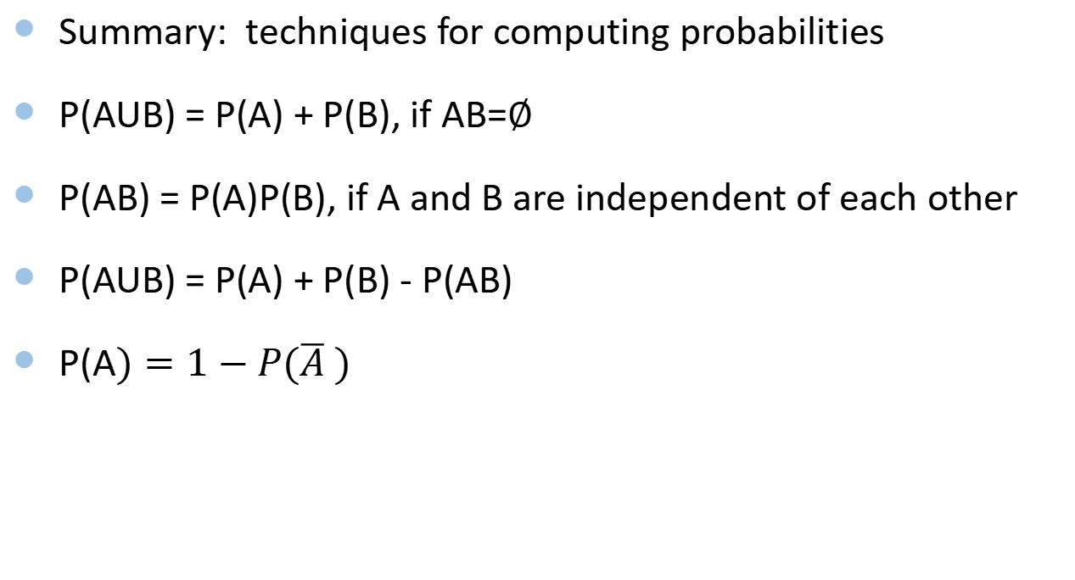
Probability
Summary: techniques for computing probabilities
P(AUB) = P(A) + P(B), if AB=$∅$
P(AB) = P(A)P(B), if A and B are independent of each other
P(AUB) = P(A) + P(B) - P(AB)
P(A$)=1−P(\overline{A} )$

Slide 26
Applications

Slide 27

Birthday Problem
How many randomly selected people are needed for there to be a better than 50% chance that two of them will have the same birthday?
15
23
91
183
Notes:
Answer is b) 23
http://en.wikipedia.org/wiki/Birthday_problem
[TUG p156]

Slide 28
Birthday Problem: Solution
Assume the birthdays are independent (i.e., no twins), and all birthdays are equally likely
Add 1 person at a time, and calculate the probability of no match
For the 2nd person, there are 364 days that don’t match the 1st person
# of people | P(no match)
2 | 364/365
3 | P(2 no match) x 363/365
For the 3rd person, there are 363 days that don’t match the first 2 people
Probability that first 2 people don’t match
Assume the 3rd person is “independent” of the first 2 people, so we multiply

Slide 29
Birthday Problem: Solution
Repeat…
and also calculate P(match) = 1 – P(no match)
# of people | P(no match) | P(match)
2 | 364/365 | 1 – P(2 no match) = 0.00274
3 | P(2 no match) x 363/365 | 1 – P(3 no match) = 0.00820
4 | P(3 no match) x 362/365 | 1 – P(4 no match) = 0.01636
5 | P(4 no match) x 361/365 | 1 – P(5 no match) = 0.02714
… | … | …

Slide 30
Birthday Problem
50.7% chance for 23 people

Slide 31

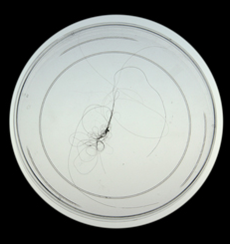

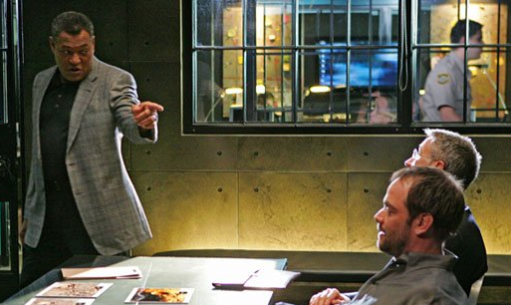
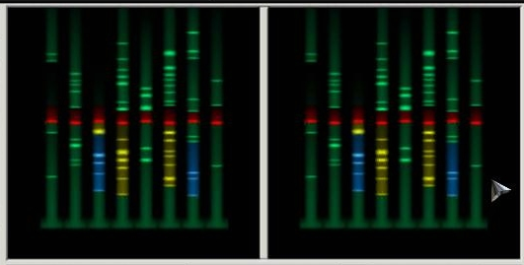
DNA Identification
Sent it to the lab for identification
CSI investigated a crime
They found a hair!
Found a match in the database
They got the suspect!

Slide 32
How DNA Fingerprinting Works
A “match” means that the two DNA fingerprints have the same pattern
It is matching 13 regions in the DNA (called loci)
How reliable is DNA fingerprinting?

Slide 33
How Reliable Is DNA Fingerprinting?
P(2 different people accidentally match one locus)
= 0.10 = 10%

Slide 34
How Reliable Is DNA Fingerprinting?
13 loci are believed to be independent of each other
Probability of all 13 loci matching in two unrelated people
P(2 different people accidentally match 13 loci) = (0.10)¹³ = 1 in 10 trillion
This is a tiny probability of an accidental match between 2 unrelated people
An accidental match is called a false positive
Accidental match

Slide 35
But…
Recall the birthday problem
If the number of people is large, the probability of a match between two different people is high
# of people | P(no match) | P(match)
100,000 | 99.95% | 0.05%
500,000 | 98.76% | 1.24%
1,000,000 | 95.15% | 4.85%
5,000,000 | 28.84% | 71.16%
10,000,000 | 0.69% | 99.31%
In the US, the FBI DNA database contains about 10 million entries
Notes:
CODIS = Combined DNA Index System
-- probability any 2 match --
size = 100000
log p(no match) = -0.000497374941233
p(no match) = 0.999502748729
p(match) = 0.000497251270821
size = 500000
log p(no match) = -0.0124344730068
p(no match) = 0.987642515618
p(match) = 0.012357484382
size = 1000000
log p(no match) = -0.0497379417652
p(no match) = 0.95147873467
p(match) = 0.04852126533
size = 5000000
log p(no match) = -1.24344953889
p(no match) = 0.288387695585
p(match) = 0.711612304415
size = 10000000
log p(no match) = -4.97379865294
p(no match) = 0.00691682345567
p(match) = 0.993083176544
size = 50000000
log p(no match) = -124.344976271
p(no match) = 9.94633203547e-55
p(match) = 1.0
size = 100000000
log p(no match) = -497.379910058
p(no match) = 9.78700143862e-217
p(match) = 1.0

Slide 36
Cold Hit on DNA Fingerprint
For a particular DNA sample, check if there is a DNA sample in the database matching it
From two different people
Size of DNA database | P(the cold hit was an accidental match) 13 loci
100,000 | 1 in 100 million
500,000 | 1 in 20 million
1,000,000 | 1 in 10 million
5,000,000 | 1 in 2 million
10,000,000 | 1 in 1 million
100,000,000 | 1 in 100,000
8 loci
1 in 1,000
1 in 200
1 in 100
1 in 20.5
1 in 10.5
1 in 1.58 = 6 in 10
In the past, only 8 loci were used. The reliability was not so good!
Notes:
1-(1-P)^N ~ NP when P is small than 1/N 1 – (1 - np) = np
Binomial expansion (a+b)^n = a^n +n a^(n-1) b

Slide 37
DNA Fingerprint Summary
DNA fingerprinting has a low probability of accidental matching (false positive)
1 in 10 trillion
For large databases,
Significant probability that at least 2 different people will match
Note: In cases where other evidence is used to find the suspect, then DNA fingerprint is very reliable

Slide 38


Engine Failure
What is the probability of multiple engine failure in an airplane?
(Most airplanes are designed so that they can remain in flight with just one engine)
Notes:
failure rate of engines

Slide 39

Single Engine Failure
For a jet engine, probability of failure in one flight-hour
P(failure) = 1/14000 = 0.0071%
P(okay) = 1 – 0.000071 = 99.9929%
Single engine aircraft (per 1 flight-hour)
Event | Probability
Engine fails | 0.0071%
Engine okay | 99.9929%
1 in 14000
Notes:
failure rate of engines

Slide 40
Twin-Engine Airplane
Assume the two engines operate independently
So, the events of an engine failing are independent
Only 1 engine fails | 2 x p x (1 – p) | 0.0142846%
Event | Formula | Probability
Both engines fail | p * p | 0.0000005%
1 in 200 million
At least one engine works | 1 – (p * p) | 99.9999995%
Both engines okay | (1 – p) * (1 – p) | 99.9857148%
2 ways for 1 engine to fail
P(1st fails, 2nd okay) = P(1st okay, 2nd fails)

Slide 41
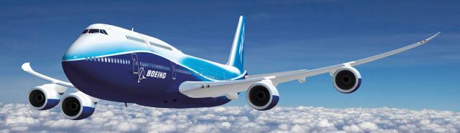
Four-Engine Airplane
Event | Probability | Odds
4 engines fail | 0.0000000000000026% | 1 in 38.4 quadrillion
3 engines fail | 0.000000000144% | 1 in 694 billion
2 engines fail | 0.00000306% | 1 in 32.7 million
1 engine fails | 0.0286% | 1 in 3500
no engine fails | 99.9714% | 9997 in 10000
Notes:
exercise to you to figure out the formulas
0 engine failed = (1-P)^4 = 0.99971431632507
1 engine failed = 4 x (1-P)^3 x P = 0.0002856530656
2 engine failed = 6 x (1-P)^2 x P^2 = 0.00000003060786
3 engine failed = 4 x (1-P) x P^3 = 0.00000000000144
4 engine failed = P^4 = 1/(14000^4) = 1/(14^4) * (1/1000)^4 = 0.00002603082049 * (1/1000)^4

Slide 42
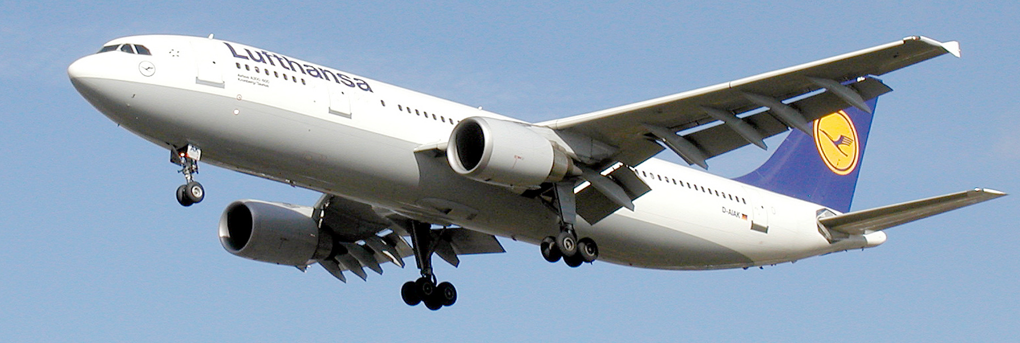
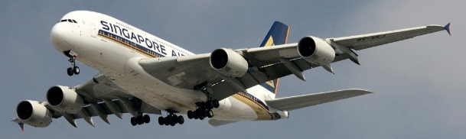
Summary
Why do most passenger airplanes have at least 2 engines?
Redundant engines reduce chance of complete failure
But also increases probability of at least 1 failure!
Aircraft | Probability all engines fail | Odds
Single engine | 0.0071% | 1 in 14000
Twin-engine | 0.0000005% | 1 in 200 million
Four-engine | 0.0000000000000026% | 1 in 38.4 quadrillion
Aircraft | Probability at least 1 engine fails | Odds
Single engine | 0.00714% | 1 in 14000
Twin-engine | 0.01429% | 1 in ~7000
Four-engine | 0.02857% | 1 in ~3500

Slide 43
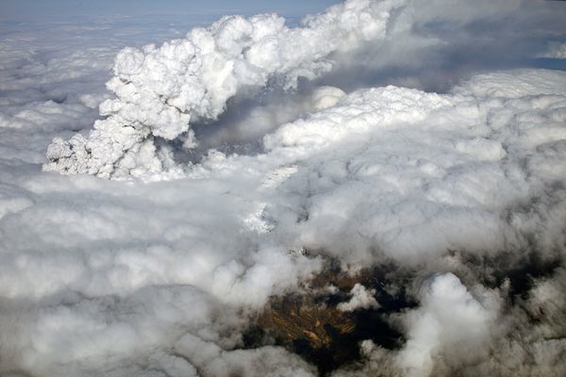
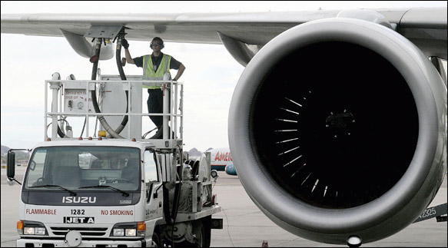
Question
Is the assumption that the “engines operate independently” okay?
Why or why not?
Any examples?
Notes:
Is the assumption “two engines are independent” okay?
Just ask the question…they will answer it in the exercises.
===
Maybe not: they are on the same airplane, so certainly correlated (they use the same air, and are connected through the same fuel system).
examples:
iceland volcano – affects all air going into engines
bad fuel – affects fuel going into engines

Slide 44
Electronic System
An electronic system consists of several components, and the reliability is shown. Find the probability that the entire system works.

Slide 45
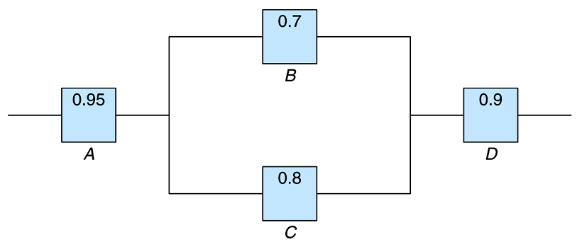
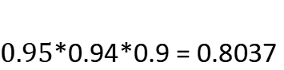
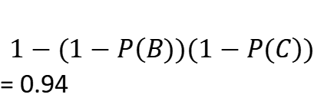
$$1−(1−P\left(B))(1−P(C\right))$$
= 0.94
$0.95$*0.94*0.9 = 0.8037

Slide 46
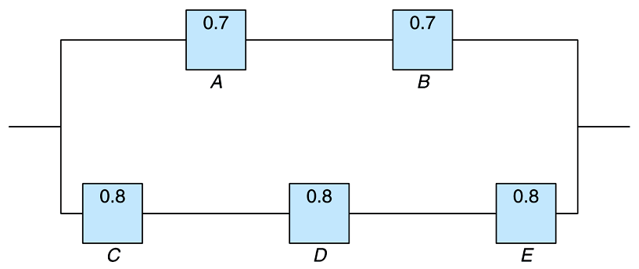
$$P\left(A\right)∗P\left(B\right)=0.49$$
$$P\left(C\right)∗P\left(D\right)∗P\left(E\right)=0.512$$
1-(1-0.49)*(1-0.512) = 0.75112

Slide 47
Summary
Some terminologies and definition of probability
How to computer probabilities
Some examples

Slide 48
Exercise (Optional)
Variants of the birthday problem
https://en.wikipedia.org/wiki/Birthday_problem#Other_birthday_problems
Binomial theorem
https://en.wikipedia.org/wiki/Binomial_theorem

